Slide 1

DR. D. Y. PATIL INSTITUTE OF TECHNOLOGY
(formerly Dr. D. Y. Patil Institute of Engineering and Technology)
Sant Tukaram Nagar, Pimpri, Pune.
PBL PROJECT
DEPARTMENT OF ARTIFICIAL INTELLINENCE AND DATA SCIENCE
Second Year Engineering
Year: 2021 - 2022
Group ID: 11
Presented by
SAI&D02 Prathamesh Patil
SAI&D07 Ganesh Jagzap
SAI&D08 Jay Sawant
SAI&D09 Atharv Wankhede
Guided by
- Mrs. Shubhangi Vairagar

Slide 2
Heart Disease Prediction System

Slide 3
Agenda
Introduction
Problem Statement
Literature Survey
Algorithms
Archicture Diagram
Use Case Diagram
Advantages & Disadvantages

Slide 4
Introduction
A study shows that from 1990 to 2016 the death rate due to heart diseases have increased around 34 per cent from 155.7 to 209.1 deaths per one lakh population in India.
Thus preventing Heart diseases has become more than necessary. Good data-driven systems for predicting heart diseases can improve the entire research and prevention process, making sure that more people can live healthy lives.
This is where Machine Learning comes into play. Machine Learning helps in predicting the Heart diseases, and the predictions made are quite accurate.
A dataset is formed by taking into consideration some of the information of some individuals. The problem is based on the given information about each individual we have to calculate that whether that individual will suffer from heart disease.

Slide 5
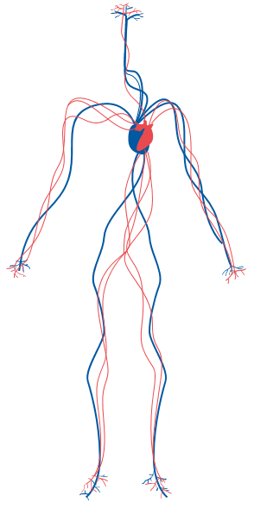

Problem Statement
Create a heart disease prediction system using machine learning where diseases are predicted by the machine learning algorithm on the basis of the symptoms provided by the user.
Heart Disease Predicted

Slide 6
Literature Survey
Name of the Paper: -IJERT-Heart Disease Prediction using Machine Learning
Authors: - Apurb Rajdhan, Avi Agarwal, Milan Sai, Dundigalla Ravi, Dr. Poonam
Ghuli. Year: - 04-April-2020
Advantages: -
1)Using random forest accuracy up to 90.6% can be achieved.
2)By testing with multiple algorithms we can get higher accuracy level for the same dataset.
Disadvantages: -
1)Dataset is limited, higher accuracy can be achieved with more flexible inputs with a larger
dataset.

Slide 7
Literature Survey
2) Name of the Paper: -Heart Disease Prediction using Machine Learning Techniques.
Authors: - Devansh Shah, Samir Patel, Santosh Kumar Bharti Year: - 2 October 2020
Advantages: -
1)Using random forest accuracy of 91% was achieved for people’s dataset it was about 97%.
2)By testing with multiple algorithms we can get higher accuracy level for the
same dataset.
Disadvantages: -
1)Decision tree performed the worst by giving predictions with accuracy of on 42%.
2)Dataset is limited, higher accuracy can be achieved with more flexible inputs
with a larger dataset.

Slide 8
Literature Survey
3) Name of the Paper: -Heart Disease Prediction using Hybrid machine Learning Model
Authors: - Dr. M. Kavitha, G. Gnaneswar, R. Dinesh, Y. Rohith Sai, R. Sai Suraj
Year: -26 February 2021
Advantages: -
1)Using the hybrid of decision tree and random forest accuracy of 88% was achieved.
2)Due to use of combination of algorithms the ML model is more flexible to multiple different
use cases.
Disadvantages: -
1) Hybrid algorithms of other classification algorithms are not used which may give better results.
2)Dataset is limited, higher accuracy can be achieved with more flexible inputs with a larger
dataset.

Slide 9
Algorithm
Random forest is a Supervised Machine Learning Algorithm that is used widely in Classification and Regression problems. It builds decision trees on different samples and takes their majority vote for classification and average in case of regression.
One of the most important features of the Random Forest Algorithm is that it can handle the data set containing continuous variables as in the case of regression and categorical variables as in the case of classification. It performs better results for classification problems.

Slide 10
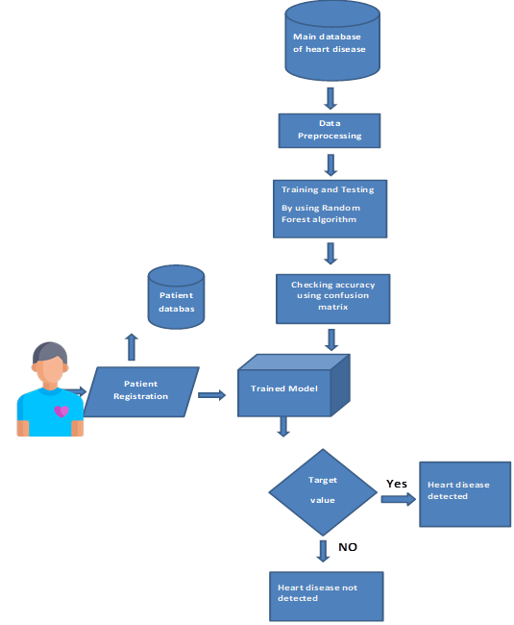
System Architecture

Slide 11

Use Case Diagram
Database
Enter Details
Random Forest
Result
User
Admin

Slide 12

Advantages & Disadvantages
Due to the recent advancement of tools and techniques for data analytics, disease risk prediction can leverage large amounts of semantic information, such as demographics, clinical diagnosis and measurements, health behaviors, laboratory results, prescriptions and care utilization
Prediction of cardiovascular disease results is not accurate.
Data mining techniques does not help to provide effective decision making.
Cannot handle enormous datasets for patient records.
People may not trust at early stages of the deployment of the system.
With big data growth in biomedical and health care communities, accurate analysis of medical data benefits early disease detection, patient care.
Clinicians can then take appropriate measures to avoid or minimize the risk and in turn, improve quality of care and avoid potential hospital admissions.

Slide 13
THANK YOU

